Slide 1

Computer Science Principles
Logic with Boolean Statements
//we need a JavaScript program that will allow students to input a number and store it in a variable g
Unit 3 Lesson 11
Code.org® and the CODE logo are trademarks of Code.org.

Slide 2
Try this
if ( g >=70 && g < 80)
grade = “C”;
What happens when g =
75?
70?
80?
90?
Notes:
Discuss with students

Slide 3
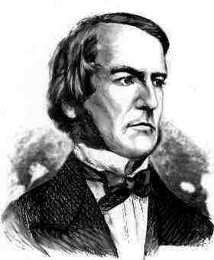
Boolean
Let’s combine conditional statements to test more than one condition at a time with “AND”.
The && is an AND – it means that both sides have to be true for the whole thing to be true.
George Boole

Slide 4
Try this
if ( g < 0 || g > 100)
grade = “not valid”;
What happens when g =
75?
100?
101?
-5?
Notes:
Point out that there are no numbers that can be both < 0 AND > 100

Slide 5
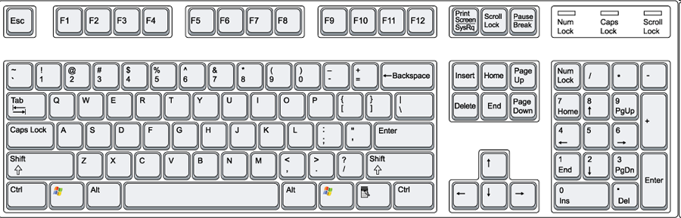
Boolean
Notes:
Sometimes students have a hard time finding the | key

Slide 6
Boolean
Let’s combine conditional statements to test more than one condition at a time with “OR”.
The || is an OR– means that the statement is only false when both sides are false. The statement is true even if only 1 of the conditions is true.
George Boole

Slide 7
Boolean
AND && Both must be true
OR || One or both is true
NOT ! takes the opposite
Example:
if ( x >=77 && x < 85)
grade = “C”;
Notes:
Stop here to point out the pattern – we are getting 0, 1, 2, 3, 0, 1, 2, 3…
Also

Slide 8
Try this
if ( g >= 90 && <= 100)
grade = “A”;
What happens?
Notes:
Students often think they can only put the variable in once – point out that the computer is very literal. By the time is gets to the <= 100 it has “forgotten” it was working with g. People can remember things like this and infer we meant g <= 100.

Slide 9
Discuss:
Used to:
Which programs have you created in this class that would have been easier to program if you had used Boolean conditions?

